Slide 1
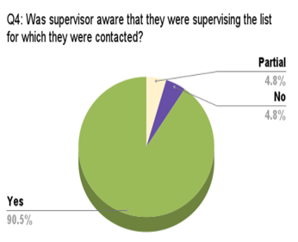
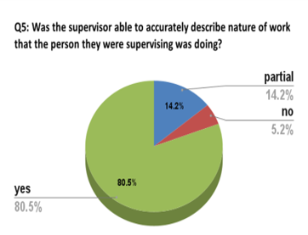
CAPPUCCINI TEST: An Audit of Supervision
Almas Iqbal¹, Huma Saleem¹, Romana Durrani^{1.,2 :} Consultant Anaesthesia 1: Shuakat Khanum Memorial Hospital & Cancer Research Centre, Lahore, Pakistan, 2: Pilgrim Hospital ULHT, UK
Introduction/Objective:
All patients receiving anesthesia are under the care of a named anesthesia consultant. Trainee doctors work under supervision of anesthesia consultants.
This audit Cappuccini test, is named after Frances Cappuccini, whose death inquest raised concerns about supervision levels.
The Royal College of Anesthetist (RCoA) developed this audit tool to assess the supervision level provided to trainee anesthetists to improve patient safety. The aim is to determine if there are any safety issues due to provided level of supervision.
Results %age Breakdown of Audit Questions & Trainee Anesthetist level
Training year | 1& 2 | Year 3 | 3 | 4 +
 | 4.8% | 57.1% | 57.1% | 38.1%
Supervision | 100%
Q1 | 100%
Q2 | 100%
Q3 | 100%
Q4 | Yes | No |  | Partial
 | 90.5% | 4.8% |  | 4.8%
Q5 | Yes | No |  | Partial
 | 81% | 5.3% |  | 14.3%
Recommendations
Creating awareness amongst consultant Anaesthetist to be more meticulously aware of the work being done under their supervision.
Re-audit with brief explanation of factors in that particular instance that led to lapses in achieving standard.
Method:
We identified twenty-one (21) elective lists over a time period of 6 weeks, in which trainee anesthetists were involved in patient care under supervision of anesthesia consultant.
Auditor asked the trainee anesthetist two questions:.
Q1. Who is supervising you (name)?
Q2. How would you get hold of them if you needed them now?
The auditor contacted supervising consultants using answers to question 2 and asks further questions.
Q3. Which lists/ who are you supervising?
Q4. Do you know about cases being done & are there any issues?
Q5. If called for help, would you be able to attend
Acknowledgement/Approval:
No funding was involved
It was conducted after approval of Ethics & Audit committee of the SKMH&RC Lahore, Pakistan.
Conclusion
This is a good system of contacting anesthesia consultants and their availability to attend in case of help required. However, there is room for improvement for supervising consultants to be aware of the complexity of cases being done under their supervision.
Reference: The Royal College of Anesthetist, Cappuccini Test. Available at: Cappuccini Test | The Royal College of Anaesthetists (rcoa.ac.uk).

